Slide 1
GLUCOSENSE: AI-POWERED DIABETES DETECTION FOR EARLY INVENTION Presented by: Chede Rethasvi

Slide 2
To leverage AI to accurately and effectively detect diabetes at the earliest stages, enabling timely intervention and improved patient outcomes. By empowering individuals to take proactive steps in managing their health, we aim to prevent the development of serious complications and improve overall quality of life
OBJECTIVE

Slide 3

INTRODUCTION
Glucosense is an innovative AI driven system designed to detect diabetes early.
Early detection significantly improves patient outcomes and reduces healthcare costs.
The technology leverages advanced algorithms and machine learning for accurate predictions.

Slide 4

The Importance of Early Detection
Prevent Complications: Early intervention can help prevent long-term complications like heart disease, nerve damage, and vision loss.
Manage Blood Sugar Levels: Prompt diagnosis allows for early management of blood sugar levels, reducing the risk of severe health issues.

Slide 5
How Glucosense Works
Utilizes AI algorithms to analyze user data, including glucose levels, lifestyle factors, and medical history.
Identifies patterns and anomalies that may indicate the presence of diabetes, even before traditional symptoms arise.
Provides personalized insights and recommendations to users, enabling them to take proactive steps towards their health.

Slide 6
Steps Involved
Data Collection
Data Exploration (EDA) and Data Preprocessing
Feature Selection and dimension reduction approaches
Build a classification model
Evaluation metrics

Slide 7
Models Applied to the Dataset
Logistic Regression (LR)
Support Vector Machine (SVM)
Random Forest (RF)
Decision Tree (DT)
Extra Trees (ET)
Gradient Boosting (GB)

Slide 8
Metrics For Modelling
Model | Accuracy | Precession | Recall | F1 Score
Logistic Regression | 0.823529 | 0.822861 | 0.823529 | 0.813072
Support Vector Machine | 0.921569 | 0.921947 | 0.921569 | 0.920044
Random Forest | 0.941176 | 0.940959 | 0.941176 | 0.940642
Decision Tree | 0.843137 | 0.842132 | 0.843137 | 0.836172
Extra Trees | 0.921569 | 0.921947 | 0.921569 | 0.920044
Gradient Boosting | 0.901961 | 0.903628 | 0.901961 | 0.898904

Slide 9
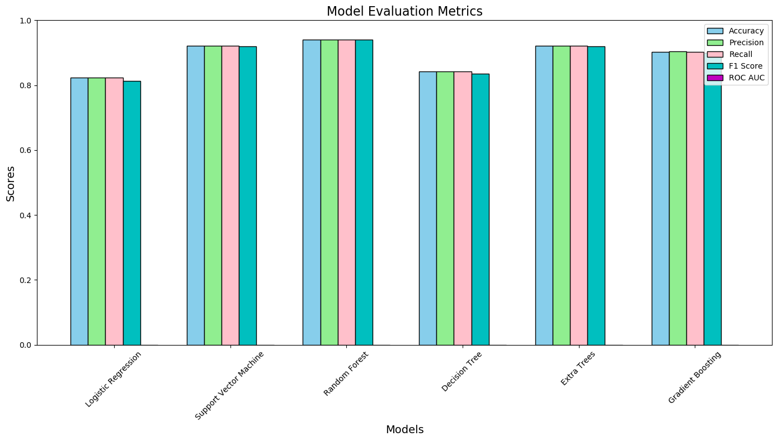
Model Evaluation Metrics

Slide 10
Benefits of AI in Diabetes Detection
AI enhances the accuracy of diabetes predictions by processing vast amounts of data.
Machine learning models continuously improve, adapting to new health trends and findings.
The technology reduces the burden on healthcare systems by streamlining diagnosis processes.
AI algorithms achieve high accuracy in diabetes detection, surpassing traditional methods.
AI-powered detection enables earlier intervention, improving patient outcomes

Slide 11
Conclusion
Based on the analysis random forest model is the best.
Reason:
* It gives best overall performance
* It achieves highest accuracy (0.941176), precision(0.940959), recall(0.941176),f1-score (0.940642) among all models.
* It ensures reliable predictions and capturing the majority of true positives.
* Random forest is suitable for small datasets
* It reduces the risk of overfitting while effectively handling small datasets.
* Compared to remaining models, random forest is computationally less complex, making it faster and easier.
* Hence, random forest is the best choice due to its performance and efficiency for small datasets, ensuring optimal predictions with minimal complexity. Where as other models extra trees, SVM, and decision tree fall short in overall performance metrics compared to random forest.

Slide 12

Future Developments and Innovations
GlucoSense is continuously evolving with advancements in AI and data analytics.
Future updates aim to enhance predictive capabilities and user engagement features.
The goal is to expand the platform’s reach to underserved populations globally.

Slide 13
THANK YOU
Mr.Ravi
Mentor- InfosysInternshipProgram
springboardmentor431n@gmail.com

